Slide 1
Final Presentation
Pac-Man Game
Team: BugOnTheFly
Angel Chu, Yujia Wang, Yanqiao Wang, Weilin Zhang, Zixuan Zhang
Notes:
Main title: 40 pt. Arial
Presenter Name: 16 pt. Arial
Presenters Title: 16 pt. Arial Italic

Slide 2
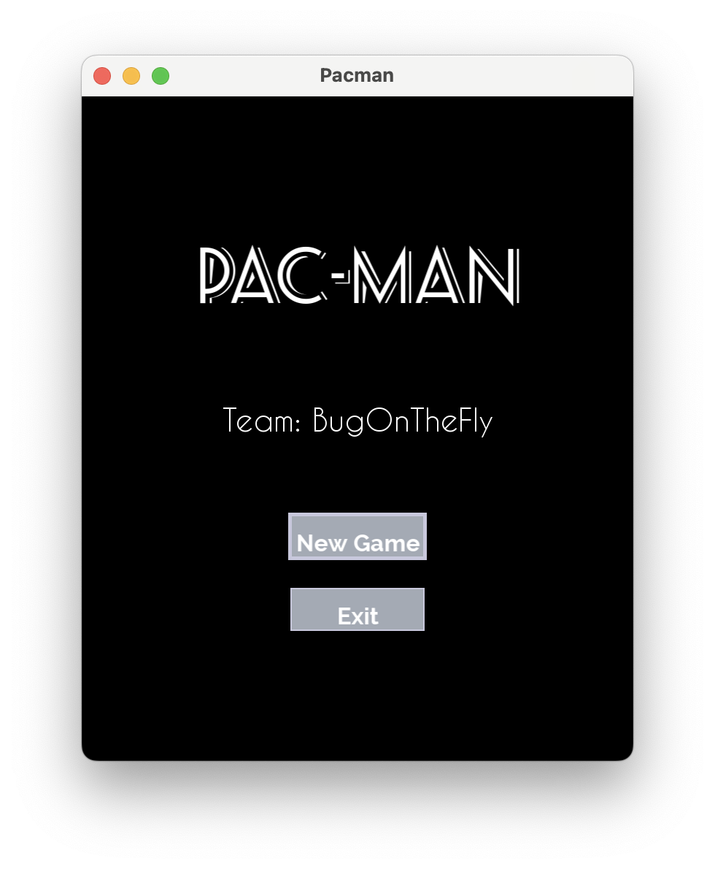
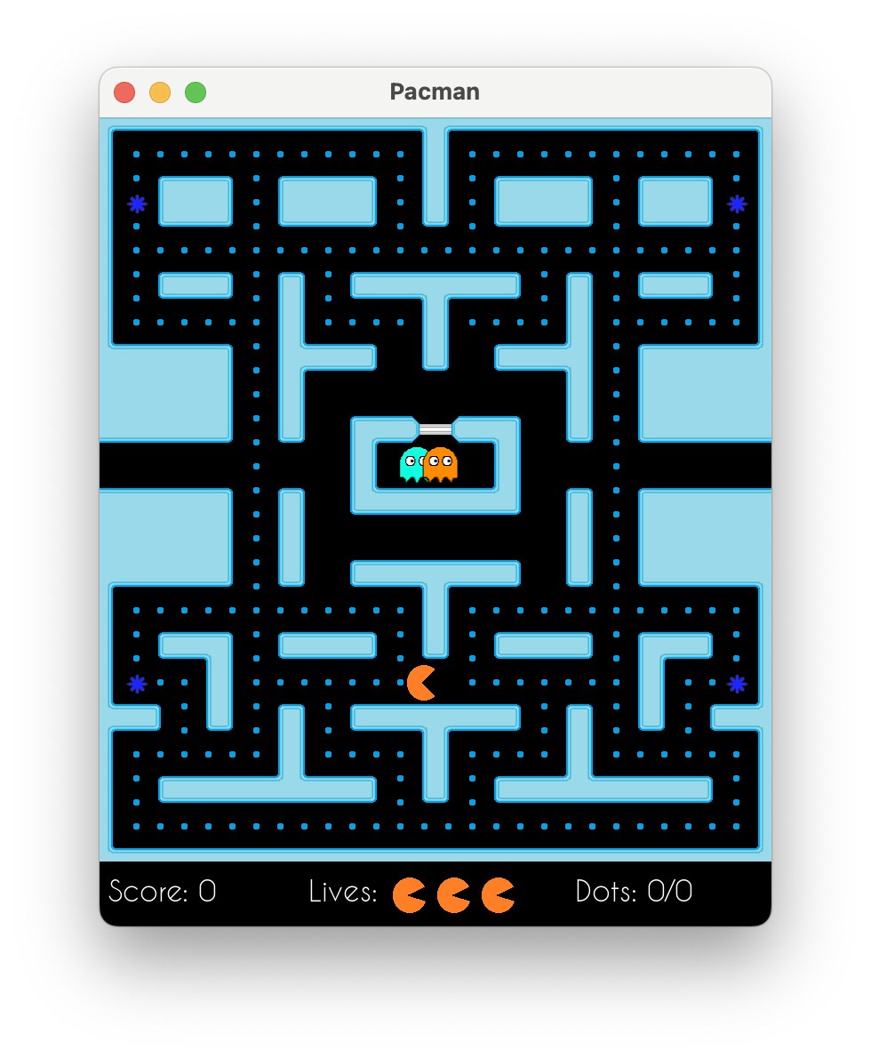
Product Overview
GUI:
Menu
Game Scene
Current Score
Lives remaining
Dots Eaten
Inherited most of the feature from the classic Pacman Game

Slide 3
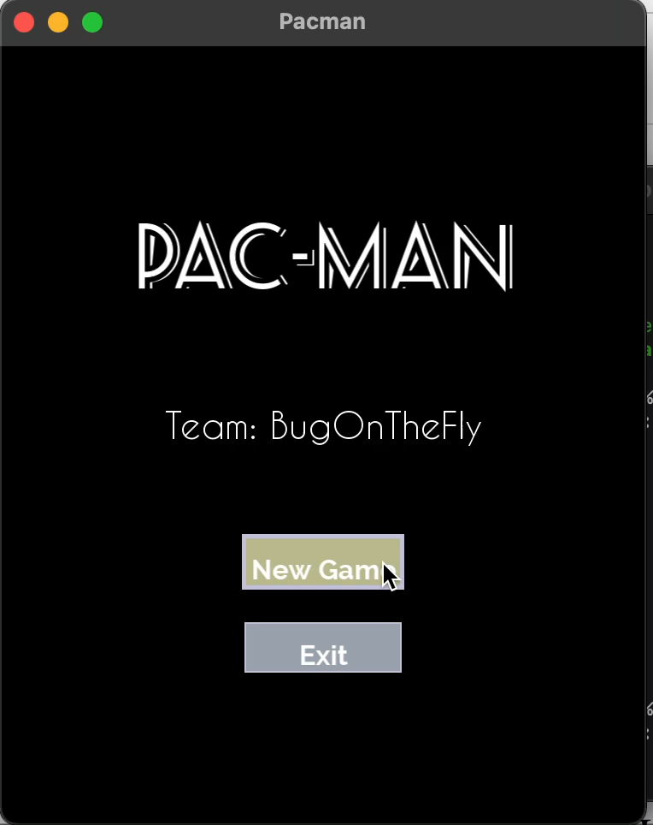
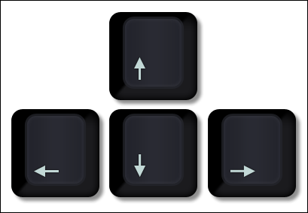
Game Instruction
Menu:
Mouse click/ Press Enter
PacMan Movement:
Press Up, Down, Left, Right
Game Pause:
Press “P”

Slide 4
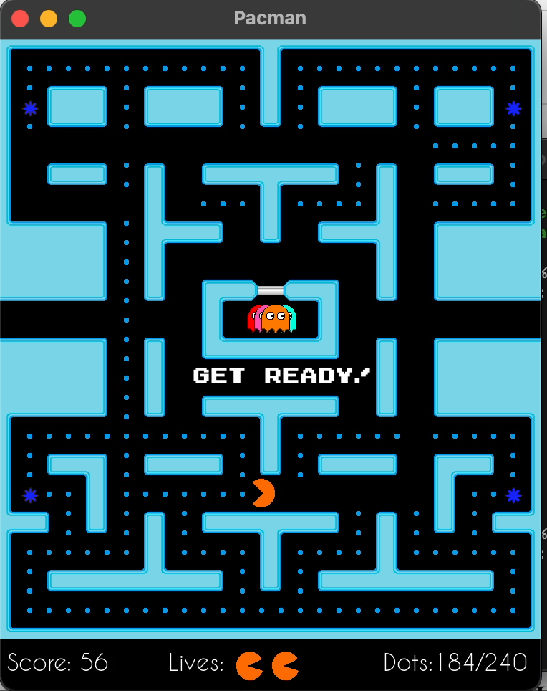
Product’s Advantages
Why it is fun?
Classic Arcade Game with interesting feature and characters
Easy to get started
Have intriguing background music

Slide 5
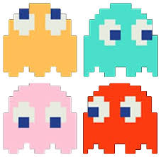
Game Implementation
Graphical Library: SFML
Classes for different purpose
e.g. Class for ghost frightened state, scatter state, chase state…
Algorithm:
Blinky: target tile in Chase state is defined as Pac-Man's current tile
first out
Pinky: target tile in Chase state is defined as where Pac-Man is going
Inky: target tile in Chase state is defined as Pac-Man's pos & dir, as well as Blinky's pos in calculation.
Last out
Clyde: target tile in Chase state is defined as if distance to PacMan > 8 tiles, same as Blinky, if distance <= 8 tiles, same as its scatter state.
Notes:
Scatter for 7 seconds, then Chase for 20 seconds.
Scatter for 7 seconds, then Chase for 20 seconds.
Scatter for 5 seconds, then Chase for 20 seconds.
Scatter for 5 seconds, then switch to Chase mode permanently.

Slide 6
Job distribution
Team Member | Responsibility
Angel Chu | GUI, Main Menu
Zixuan Zhang | GUI, Game Scene
Yujia Wang | Game Design, Code Integration
Yanqiao Wang | Game Controller, Timer
Weilin Zhang | Ghost States, Pacman Controller

Slide 7
Thank You

